Slide 1

What is a Predictive Model?
Matthew Engelhard
Notes:
Hi Everyone
Today we’ll be building some intuition around predictive models,
which are really the central concept we’ll be learning about in this course
By the end of this lecture, I hope you’ll have a stronger sense of what a predictive model is
and the wide variety of ways in which predictive models are deployed,
or might be deployed, in a healthcare setting
We’ll also take a very brief, initial look at model training and evaluation,
but these topics will be covered later in much more detail
Ok, so let’s get started!

Slide 2
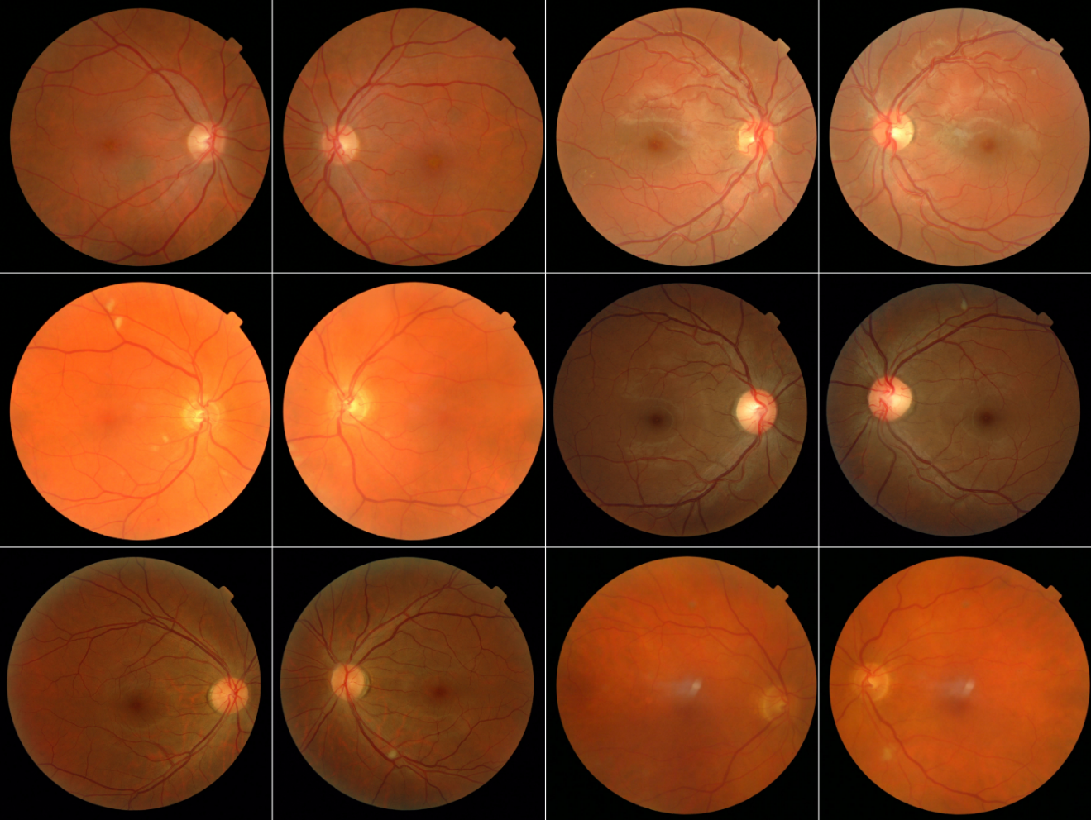
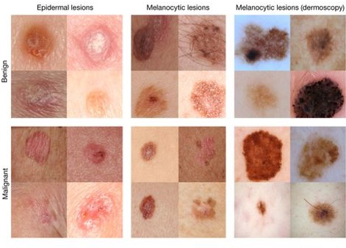

Medical Image Analysis with ConvNets
Improved Automated Detection of Diabetic Retinopathy
Invest. Ophthalmol. Vis. Sci.. 2016;57(13):5200-5206. doi:10.1167/iovs.16-19964
Dermatologist-level classification of skin cancer
Nature volume 542, pages 115–118 (02 February 2017)
Notes:
In the coming weeks, we’re going to be talking about state of the art predictive modeling techniques that are becoming more and more central to the practice of medicine
Call it data science, machine learning, AI -- we'll see if we can unpack those terms a little bit later on – but whatever you want to call it, we've got increasingly complex models that thrive on big healthcare datasets. And they’re being used to inform healthcare decision-making, so we need to understand what they can and can’t do, know how to interpret what they’re telling us and how to use them to our advantage, and above all know how to critically evaluate them.
We’re going to be talking about computer vision, which has been used to identify referrable diabetic retinopathy as effectively as retina specialists.
This is done by applying a specific kind of predictive model, called a convolutional neural network, to fundoscopic images, and there are several papers that have reported on this specific prediction task – the example I’ve given on the left is not the only paper that’s shown this.
Computer vision has also been used to identify carcinomas and melanomas as effectively as dermatologists without the need for an in-person visit. This was shown in the paper cited at right, which many of you will be evaluating later in the course.

Slide 3
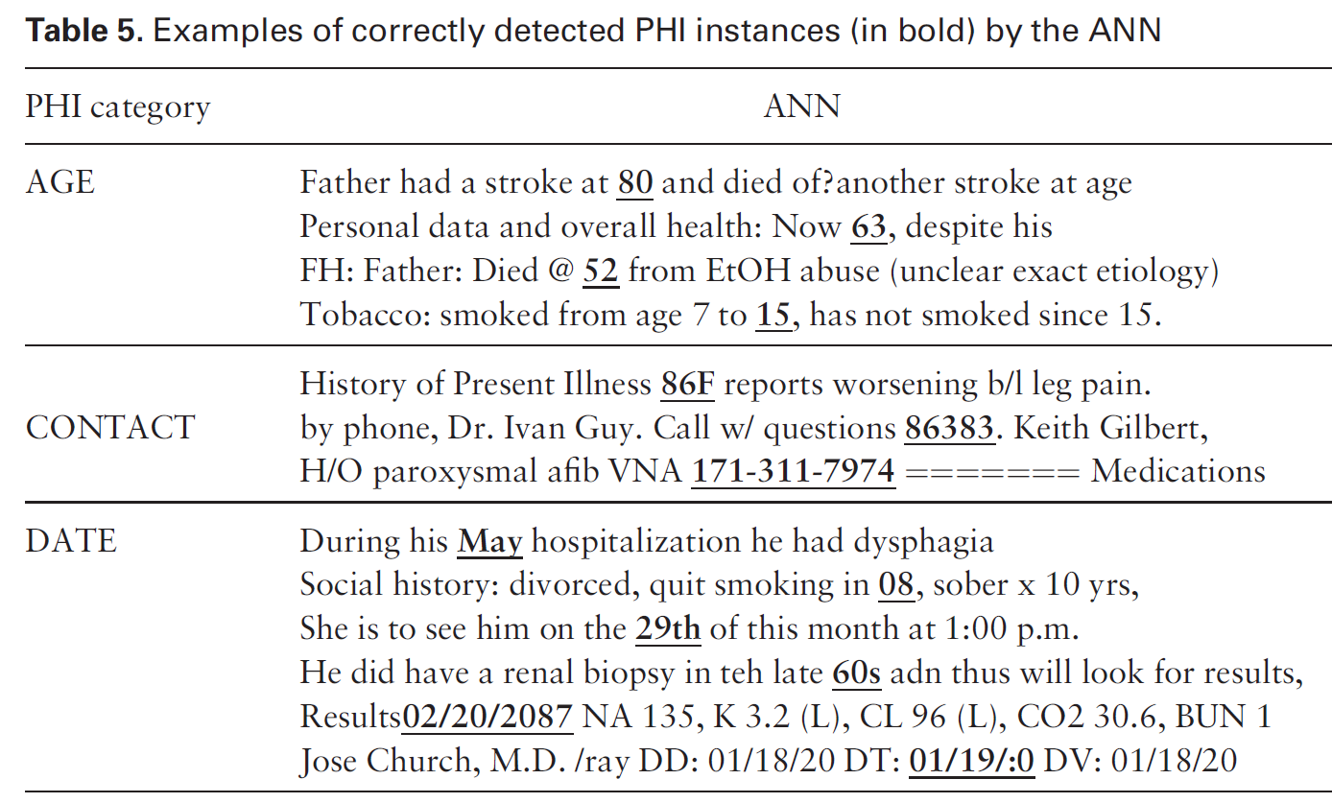
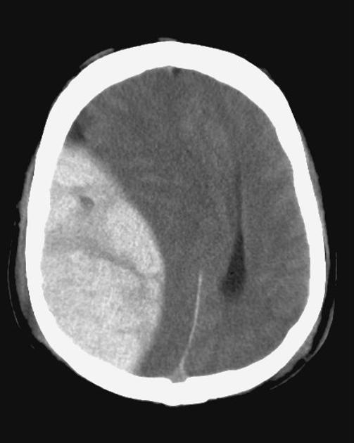
Biomedical Text Processing
Classification of radiology reports using neural attention models, IJCNN 2017
De-identification of patient notes with recurrent neural networks
JAMIA 24(3), 2017, 596–606
Mass effect from extradural hemorrhage
https://radiopaedia.org
Notes:
After that we’ll be talking about natural language processing – NLP -- which allows us to make predictions associated with clinical notes and other documents
On the left, we have a reference to a paper in which NLP was used to read radiology reports and determine whether a number of specific findings were present. The image shows a mass effect –brain tissue has been pushed to one side by bleeding outside the membrane surrounding the brain – which is one of the findings that this model can identify from radiology reports. Again, this I’m showing the image here, but this model is working from the reports, not the images themselves.
And then on the right, we have a paper showing that NLP – specifically, a type of model called a recurrent neural network that is commonly used in NLP – was better than a bunch of different expert systems at de-idenfying discharge summaries. De-identifying clinical text is incredibly time consuming, so having a tool that’s able to do this well is quite useful

Slide 4
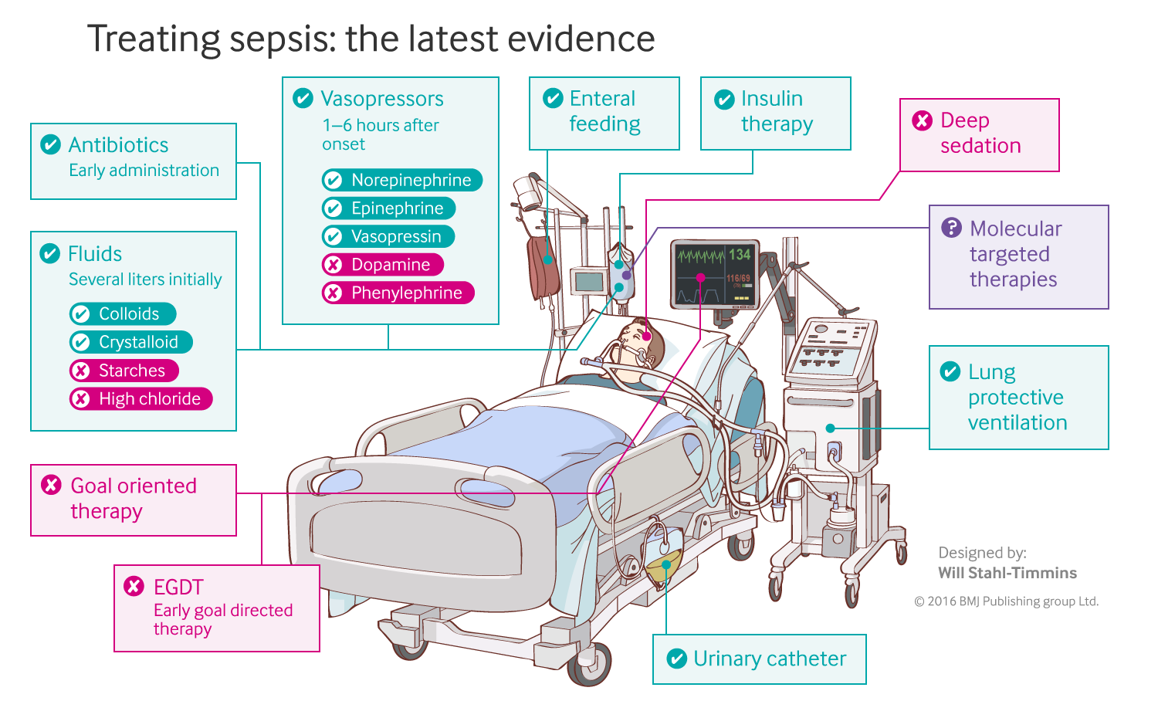
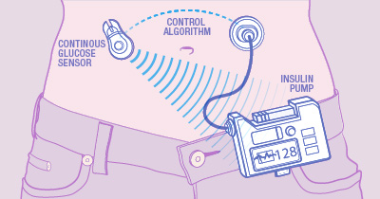
Sequential Prediction and Decision-Making Algorithms
Closed-loop blood glucose control
(“artificial pancreas”)
Fluid and vasopressor administration
for sepsis treatment
https://www.mayo.edu/research/labs/artificial-pancreas/overview
Gotts JE, Matthay MA. Sepsis: pathophysiology and clinical management. bmj. 2016 May 23;353(i1585).
Notes:
Toward the end of the course, we’ll be talking about sequential data – for example, we might have repeated measurements collected over time
There are lots of things you can do with data like that. But one area that’s progressing really rapidly right now, it involves models that make a sequence of decisions in real time based on measurements as those measurements are collected
For example, we might like to build a system that continuously monitors blood glucose in someone with diabetes, then administers an appropriate amount of insulin in response. This is called an “artificial pancreas”, and as you may know, there are FDA-approved devices that do just this.
Or, we might be interested in systems that help us optimize outcomes among patients with sepsis in the ICU. In the paper referenced at right, the authors develop a system that recommends appropriate fluid and vasopressor administration based on measurements available at the bedside
These sequential decision-making problems can be tackled with a group of machine learning techniques called reinforcement learning
But more generally, we’ll be thinking about models that make one or more predictions or decisions based on time series or sequential data

Slide 5
In each of these cases, we have a machine that receives data and makes a related prediction: a “predictive model”
Notes:
These examples span a very broad range of techniques and very different types of data, and there’s an incredible amount of depth to each of these areas
But they all have something really important in common.
In each of these cases, we have a machine that receives data and makes a prediction in response.
And when designing such a machine, the goal is to make predictions that are as good as possible – later we’ll talk about what it means for predictions to be “good” -- given the relevant information available in the data.
Data goes in, and predictions come out – the data might be images, text, vital signs, and much more – and the predictions might be labels, numbers, or decisions
We’re concerned with making those predictions as accurate and/or as useful as possible

Slide 6
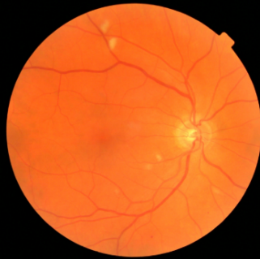
image -> prediction: computer vision
y, referrable diabetic retinopathy
x, retinal image
End goal: predict y from x
Notes:
In computer vision, the data is an image, and the prediction is often (though not always) a binary label – yes or no – that represents the model’s best guess about whether some finding or characteristic that we care about is present. In this case, we have a fundoscopic image, and the model’s predicting whether referrable diabetic retinopathy is present
We could also view this prediction as a decision, namely, whether or not to refer the patient

Slide 7
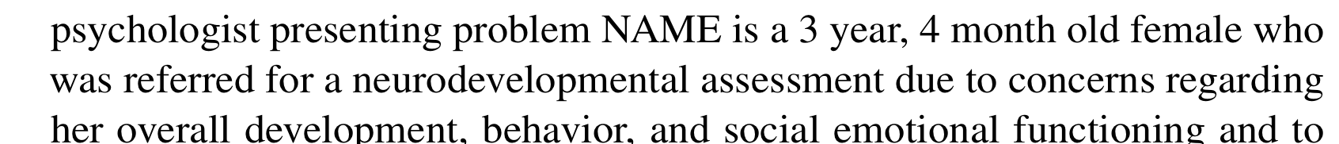
text -> prediction: natural language processing
y, autism risk
x, clinical note
End goal: predict y from x
Notes:
In natural language processing, the data is a document or portion of text, and again, the prediction is often a binary label – yes or no – indicating whether the note mentions or suggests some finding of interest
Now the prediction doesn’t have to be a yes or a no – it could be a numeric value, or it could be a label other than yes or no
And later in the course, we’ll consider some prediction tasks that are even more complicated
But in this course, we’ll be focusing on yes or no predictions for the most part. This is called binary classification.
Here at Duke, we’ve been using clinical notes to predict whether young children are at risk of developing autism later in life
Similar to before, we can view this prediction as the model’s belief about whether autism is or will be present, but we can also view it as a recommendation about whether to intervene

Slide 8

“state of the world” -> next action: reinforcement learning
y, next move
x, Go board state
End goal: predict y from x
Notes:
And in reinforcement learning, things get a little more abstract.
Here we’re considering a system that has been trained to play the game Go
As input, it receives the current board state – I sometimes like to call this the “state of the world”, as far as the model is concerned, because it’s all the information relevant to the decision at hand – and based on the board state, it predicts which move it should make next to give it the best chance of winning
In the sepsis management example from before, the “state of the world” is the patient’s physiologic status.

Slide 9

features $x$ -> prediction $y$: a predictive model
y, associated value or label
x, data/features for a subject or patient
End goal: predict y from x
Notes:
Let’s now set those examples aside and look at the general case
Suppose we have a vector of measurements (x) -- these will be the inputs to our predictive model
In this class we’ll call them features or predictors. You might also hear them called variables or independent variables, or even covariates
Associated with the features is a value or label (y) – again, this could be a binary label, a categorical label where there are more than two possible categories, or a numeric value, but in this course it’ll usually be a binary label – in other words, a yes/no prediction
We’d like to be able to take a given set of features (x) and make an accurate prediction about the corresponding value of (y)
And the thing that connects (x) to (y) – this is the ‘machine’ in machine learning – it’s the predictive model
Fundamentally the model itself is a mathematical equation, but it’s typically implemented as a computer program

Slide 10
Simple models often work well for clinical data!
WBC Count
Respiratory Rate
Creatinine
Mean BP
Hematocrit
Pulse Rate
Temperature
Survival
Age
y, associated value or label
x, data/features for a subject or patient
End goal: predict odds of hospital mortality
(APACHE III)
Notes:
In medicine, often x is a fairly simple set of features
In an ICU setting, we might want a model that takes a bunch of measurements about a patient -- their age (demographics), vitals, lab values, and some information about chronic health conditions and predicts their risk of dying (or likelihood of surviving…)
In fact, there is a well known model used for this purpose: ACUTE PHYSIOLOGY AND CHRONIC HEALTH EVALUATION – it’s been around since the 70s (we’re now on APACHE III)
Models that deal effectively with highly complex data, like images – those are fairly new
But predictive models are NOT new, AT ALL, in medicine
Think cardiology, Framingham, pooled cohort equations, etc
When you have data like these, you don’t need a super complex model – you typically don’t need a neural network
And as a rule of thumb, we don’t want to make these things more complicated then necessary – we should use the simplest and most interpretable model that will do the job

Slide 11
Before we tackle complex models, let’s carefully examine a very simple one.
x, a single measurement:
prostate specific antigen
y, associated label:
prostate cancer
(0 = absent, 1 = present)
End goal: predict y from x
Notes:
But let’s save the more complex models for later. Today we’re building intuition around (a) what the predictive model is, and (b) how it can be used
And to do that, we’re going to focus on a very simple example – just about the simplest predictive model you might realistically use (and that is in fact used in medicine)
We want to make a prediction based on a single measurement.
The one I’d like to consider is this:
Make a prediction about whether someone has prostate cancer based on a single prostate specific antigen measurement
Please note that this is for the purposes of illustration, and is very far from what’s actually done in clinical practice -- there are many more biomarkers that are used in prostate cancer surveillance

Slide 12
Prostate specific antigen measurement in individuals with vs without prostate cancer
Notes:
Let’s suppose we collected PSA values in a large number of patients
Then, we determined, through some gold standard – biopsy, let’s say – whether they have prostate cancer
Our goal is to find a best rule for predicting whether cancer is present based on the PSA alone.
If our rule works well enough, maybe it will spare us from doing so many biopsies in the future.
we’ve collected all these values, and we can group them by gold standard prostate cancer status
On the top, we have all the PSA values for individuals who did not have prostate cancer, and on the bottom, we have all the values for those who did
Points in each group are visualized in 3 different ways here.
First, we have a kernel density estimate – in other words, a smoothed histogram – that tells us which numeric values are more versus less common
Second, we have a boxplot, which does something very similar, but using familiar summary statistics like the median and interquartile range
Lastly, we have what’s called a ‘raincloud plot’, which simply plots every point, but it adds some variability to the y axis position to prevent points from overlapping too much, which would otherwise make it harder to evaluate their density in a particular area
Comparing the plots at the top to those at the bottom – we can see whether someone has cancer tells us something about what the PSA value is likely to be.
But by the same token, the PSA value can tell us something about whether someone might have prostate cancer
as the PSA value increases, cancer becomes more and more likely
It’s worth noting at none of this is not causal – nobody thinks that PSA is causing prostate cancer
But nevertheless we can use the PSA value to infer something about whether cancer is likely to be present

Slide 13
End Goal: predict cancer status (y) based on PSA (x)
Notes:
With these data in hand, let’s now build a predictive model – a very simple “machine”, or algorithm -- that will allow us to make a prediction about cancer status based on a PSA measurement

Slide 14
End Goal: predict cancer status (y) based on PSA (x)
below threshold: predict negative
above threshold: predict cancer positive
Notes:
We’re going to do this with a simple threshold – we pick a value of the PSA
When we observe a PSA value above the threshold, we’ll predict that the patient has prostate cancer
If the value is below the threshold, we’ll predict that they don’t
And so our job is to find a “best” threshold – one that distinguishes positive and negative cases effectively
to do this, we have to explore different thresholds and see how good our predictions are, based on the data we’ve collected so far, when we choose a specific threshold
We can immediately see some bad thresholds
If we choose a threshold of 0, we predict that everyone has cancer, which doesn’t seem very helpful
On the other extreme, we could choose a threshold of 15 and predict that no one has cancer – again, this doesn’t seem very useful, so really we’re looking for something in between

Slide 15
End Goal: predict cancer status (y) based on PSA (x)
below threshold: predict negative
above threshold: predict cancer positive
TRUE POSITIVES
Notes:
Once we choose a threshold, we can group points not only by their gold standard cancer status, but also by the prediction that our model would make – in other words, predicted positive versus predicted negatives
And we can divide our patients into four non-overlapping groups
First, we have the true positives – these are the patients with cancer, and for whom our model correctly predicted that they have cancer

Slide 16
End Goal: predict cancer status (y) based on PSA (x)
below threshold: predict negative
above threshold: predict cancer positive
FALSE NEGATIVES
TRUE POSITIVES
Notes:
Next we have the false negatives: these are the patients who have cancer, but our model would predict that they didn’t

Slide 17
End Goal: predict cancer status (y) based on PSA (x)
below threshold: predict negative
above threshold: predict cancer positive
Sensitivity:
% of positives correctly identified
True Positives / Positives
TP / (TP + FN)
FALSE NEGATIVES
TRUE POSITIVES
Notes:
The proportion of positive cases that the model correctly predicts are positives – that’s the sensitivity
It tells us how effective we are in catching the positive cases
We’ll come back to this and more performance metrics later

Slide 18
End Goal: predict cancer status (y) based on PSA (x)
below threshold: predict negative
above threshold: predict cancer positive
TRUE NEGATIVES
Notes:
Then, looking at those with negative cancer status, we have the true negatives: these are the negatives for whom the model correctly predicts that they are negative

Slide 19
End Goal: predict cancer status (y) based on PSA (x)
below threshold: predict negative
above threshold: predict cancer positive
TRUE NEGATIVES
FALSE POSITIVES
Notes:
And finally, we have the false positives – these are the negative cases that the model predicts are positive

Slide 20
End Goal: predict cancer status (y) based on PSA (x)
below threshold: predict negative
above threshold: predict cancer positive
TRUE NEGATIVES
FALSE POSITIVES
Specificity:
% of negatives correctly identified
True Negatives / Negatives
TN / (TN + FP)
Notes:
The proportion of negatives that we correctly predict are negatives – that’s the specificity
It tells us how effective we are in catching negative cases
Again, we’ll come back to this later

Slide 21
End Goal: predict cancer status (y) based on PSA (x)
below threshold: predict negative
above threshold: predict cancer positive
Increase the threshold:
1. Specificity goes up.
(we’re catching more negative cases)
TRUE NEGATIVES
FALSE POSITIVES
Notes:
Now ideally we’d like to have only true negatives and true positives – in other words, perfect predictions
Because when we have a false positive, we may take an action, perhaps a costly one, that was unnecessary
And when we have a false negative, in this case we’re failing to recognize that the patient has cancer and therefore failing to intervene when we should
But in reality, we’re always trading off false positives for false negatives, or vice versa. We hope to find a model with a favorable tradeoff, but no model is perfect.
As we increase our threshold, we’re labeling more cases as negative, so our specificity goes up

Slide 22
End Goal: predict cancer status (y) based on PSA (x)
below threshold: predict negative
above threshold: predict cancer positive
Increase the threshold:
1. Specificity goes up.
(we’re catching more negative cases)
2.Sensitivity goes down.
(we’re catching fewer positive cases)
TRUE NEGATIVES
FALSE POSITIVES
FALSE NEGATIVES
TRUE POSITIVES
Notes:
But, on the other hand, we’re labeling fewer cases as positive, so our sensitivity goes down
At this point, you may want to spend a moment to think about how changing the threshold changes the positive and negative predictive value
If those terms are not familiar, don’t worry – we’ll come back to them later

Slide 23
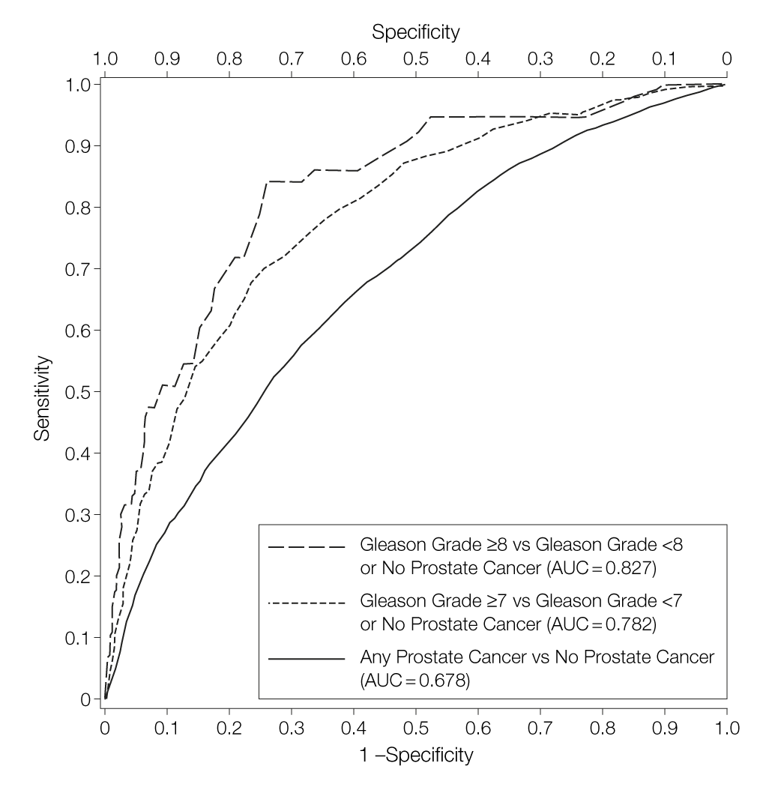
The ROC curve
(i.e. sensitivity/specificity curve)
quantifies performance across all possible thresholds
Thompson IM, Ankerst DP, Chi C, et al. Operating Characteristics of Prostate-Specific Antigen in Men With an Initial PSA Level of 3.0 ng/mL or Lower. JAMA. 2005;294(1):66–70. doi:10.1001/jama.294.1.66
Notes:
Then, having explored a range of possible thresholds, we can plot sensitivity / specificity pairs for all the thresholds we’ve considered
This helps us to understand how good a predictor PSA is under for a range of circumstances we might consider –
As an aside, we often refer to a particular threshold as an “operating point”
We might be more interested in catching positive cases
We might be more interested in ruling out cases
Sometimes you’ll hear about the “area under the ROC curve” – this is meant to quantify performance in a way that’s not tied to a particular threshold
It is often criticized, and not always the appropriate metric, but still a good one

Slide 24

The ROC curve
(i.e. sensitivity/specificity curve)
quantifies performance across all possible thresholds
We’d like to have sensitivity $≥$ 0.9
We can get specificity of about 0.27
Find the threshold corresponding to this point; we’ll suppose it’s at PSA = 2.0
Thompson IM, Ankerst DP, Chi C, et al. Operating Characteristics of Prostate-Specific Antigen in Men With an Initial PSA Level of 3.0 ng/mL or Lower. JAMA. 2005;294(1):66–70. doi:10.1001/jama.294.1.66
Notes:
Hypothetically, let’s say that our clinical team tells us we NEED a sensitivity of at least 0.9
We can always get there – remember, always predicting “positive” gives us perfect sensitivity
But the sensitivity/specificity curve tells us what specificity we can expect in return

Slide 25
Our first, very simple predictive model
End Goal: predict cancer status (y) based on PSA (x)
Our rule:
if PSA > 2.0, predict positive
else predict negative
Notes:
OK, so that was our very first predictive model – there will be many more!
We’re using data – the observed PSA level – to make a prediction about whether the person has prostate cancer
How did we choose a good threshold?
Well, we collected a bunch of data -- a bunch of PSA measurements with corresponding cancer status
We were then able to see, based on historical data – in the course, we’ll usually call this a training set – what threshold was needed to achieve a sensitivity of 0.9
Having set that threshold, we can now make cancer predictions for new patients whenever we collect a PSA
And if we collect PSA measurements in a bunch of new patients, then assess their cancer status, we can see how well our threshold performs in the new cohort, which we didn’t use to select the threshold
In other words, we can see how well our model generalizes to the new cohort.
If the new cohort is a lot like the old one, then we’d expect the threshold would perform about as well
But if the new is systematically different – say, an older cohort – then the threshold might perform very differently

Slide 26
Learning a Predictive Model from Labeled Data
y, associated value or label
x, data/features for a subject or patient
The learning process: find the equation that best predicts y based on x
Notes:
Now let’s go back to the more general case: still simple, but not quite as simple as before
We’d like to learn an equation that best predicts y based on x, which is a collection of measurements, or features, rather than a single measurement
So how do we do it?
Well, first we need to decide on the form of the equation – we can think of this as selecting a type of model
In this course, we’ll often choose logistic regression as our model – describing this model is the next topic we’ll cover
Then we’ll need to tune the equation – find specific parameters, or model coefficients, that predict y best
This is called “learning”, or “training” the model
How do we do it? Well, just like in the PSA example, we’ll need a “training set” of historical data

Slide 27
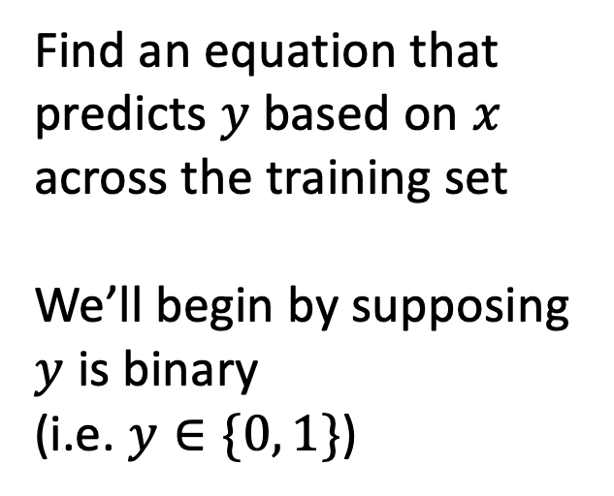
Training Set (Historical Data)
x₁
y₁
Find an equation that predicts $y$ based on $x$ across the training set
We’ll begin by supposing $y$ is binary
(i.e. $y∈\{0, 1\}$)
x₂
y₂
x₃
y₃
x₄
y₄
…
…
x_{N-1}
y_{N-1}
x_{N}
y_{N}
Notes:
we’re going to collect a bunch of data – pairs of x’s and y’s
And we want to choose the parameters that predict y best based on the x’s, on average, across this dataset
One set of parameters might do a good job predicting y1 based on x1, but not do a good job predicting y3 from x3. We want the parameters that give us the best prediction in this dataset, on average
We’ll formalize this idea later through the idea of a “loss function”

Slide 28

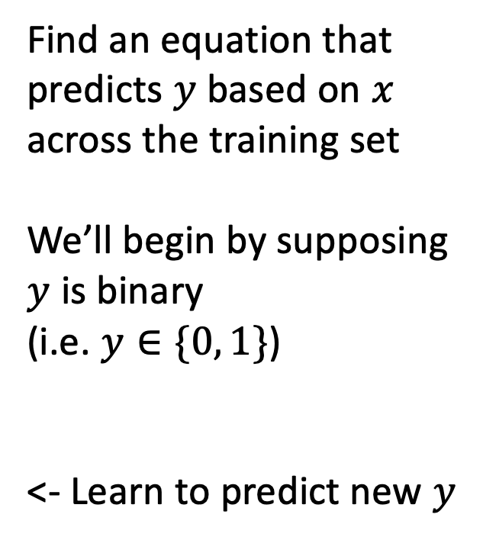
Making Predictions for New $x$
x₁
y₁
x₂
y₂
Find an equation that predicts $y$ based on $x$ across the training set
We’ll begin by supposing $y$ is binary
(i.e. $y∈\{0, 1\}$)
<- Learn to predict new $y$
x₃
y₃
x₄
y₄
…
…
x_{N-1}
y_{N-1}
x_{N}
y_{N}
x_{N+1}
y_{N+1}
Notes:
Once we decide on parameters, then, when we see a NEW value of x, we simply plug it into our “learned” equation, and it tells us what we expect y to be.
This is the prediction made by our predictive model.

Slide 29
Summary
The data science techniques we will consider in this course, from computer vision to natural language processing, are all examples of predictive models.
The predictive model is the machine in machine learning. It is a specific mathematical equation that is learned from historical data and evaluated by applying it to additional data not used in training.
Predictive models can be very simple or very complex. As a rule of thumb, we want to use the simplest model that performs well.
Notes:
Read bullet points
Thank for listening and see you next time!

